Slide 1
Introduction to Arduino Programming
Course Instructor: Tejas S Shah

Slide 2

Contents
Introduction to Arduino IDE
Syntax
Lab 1: Ex1, Ex2, Ex3
Recommended Reading (PWM) - Homework

Slide 3
Process Overview
Download and Install the IDE
Get the Arduino COM Port Number
Configure the IDE
Loading a Basic Example
Verify and Upload

Slide 4
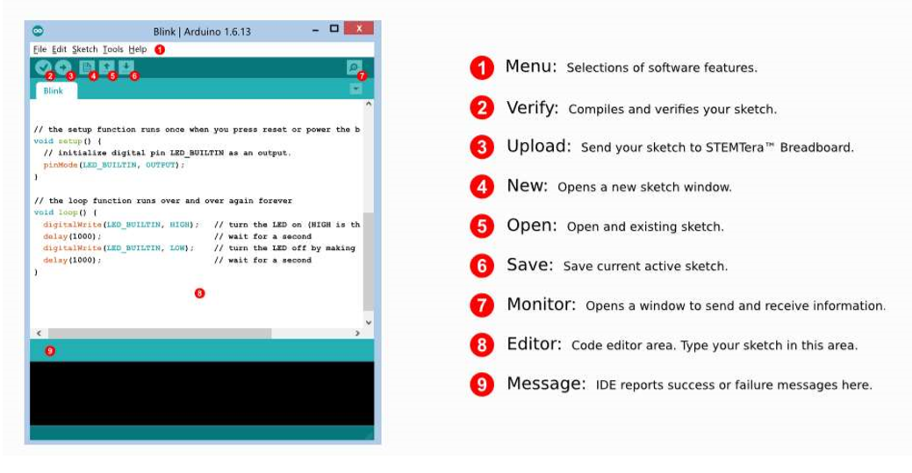
Understanding Arduino IDE
Notes:
IDE – Integrated Development Environment

Slide 5
Syntax – Basics
; semi-colons
// single line comments
/* */ multi-line comments
{ } open and closing curly braces
( ) parenthesis
void setup() – identify the opening and closing curly braces
void loop() – identify the opening and closing curly braces
#include < >

Slide 6
Syntax – Intermediate
Digital Functions
Analog Functions
Time Functions
Serial Monitor Functions

Slide 7
Digital Functions
digitalWrite(pin, value)
Sets a pin configured as OUTPUT to either a HIGH or a LOW state at the specified pin.
digitalRead(pin)
Reads the value from a specified pin, it will be either HIGH or LOW.
pinMode(pin, mode)
Configures the specified pin to behave either as an input or an output. See the reference page below.

Slide 8
Analog Functions
analogWrite(pin, value)
Writes an analog value (PWM wave*) to a pin. Can be used to light a LED at varying brightness or drive a motor at various speeds.
analogRead(pin)
Reads the value from the specified analog pin. The 10-bit Analog-to-Digital Converter (ADC) will map input voltages between 0 and 5 volts into integer values between 0 and 1023.

Slide 9
Time Functions
delay(ms)
Pauses your program for the amount of time (in milliseconds) specified as parameter.
delayMicroseconds(us)
Pauses the program for the amount of time (in microseconds) specified as parameter.
millis()
Returns the number of milliseconds since the Arduino board began running the current program

Slide 10
Serial Functions
Syntax | Use
Serial.begin( ) | To begin the Serial Monitor
Serial.read( ) | To read data from Serial Monitor
Serial.available( ) | To check if Serial Monitor
Serial.print( ) | To Print data in Serial Monitor
Serial.println( ) | To Print data in the next line in Serial Monitor

Slide 11
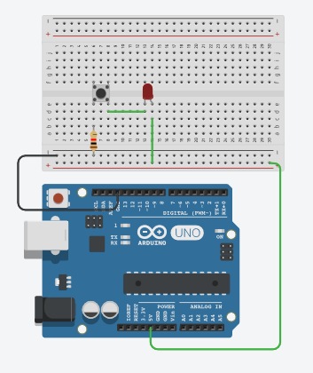
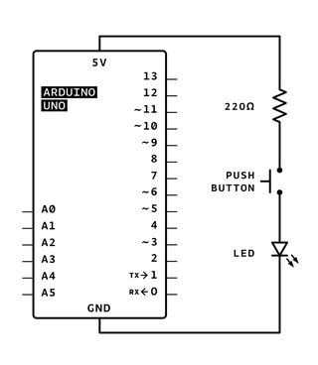
Lab 1: Playing with LEDs
Ex.1 - Getting used to TinkerCAD

Slide 12
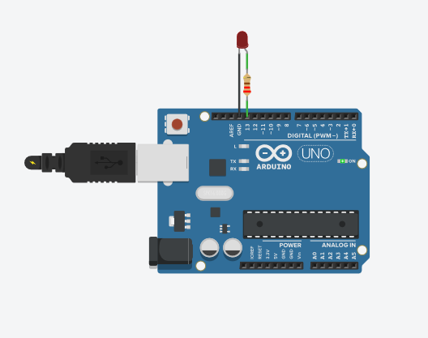
Ex.2 – LED Blink using TinkerCAD
//Code for Blink
void setup()
{
pinMode(13, OUTPUT);
}
void loop()
{
// turn the LED on (HIGH is the voltage level)
digitalWrite(13, HIGH);
delay(1000); // Wait for 1000 millisecond(s)
// turn the LED off by making the voltage LOW
digitalWrite(13, LOW);
delay(1000); // Wait for 1000 millisecond(s)
}
Notes:
https://v1.tinkercad.com/things/l0Uwn5PlPeU-blink-an-led-with-digital-output/editel?lessonid=EIC0NAWJD0K8S1O&projectid=OMOZACHJ9IR8LRE&collectionid=OMOZACHJ9IR8LRE&tenant=circuits#/lesson-viewer

Slide 13
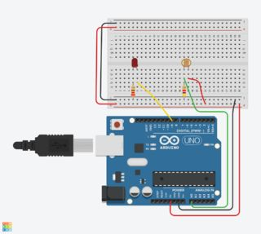
Ex.3 – Analog Function using TinkerCAD
int sensorValue = 0;
void setup()
{
pinMode(A0, INPUT);
Serial.begin(9600);
pinMode(9, OUTPUT);
}
void loop()
{
sensorValue = analogRead(A0); // read the value from the sensor
Serial.println(sensorValue); // print the sensor reading so you know its range
analogWrite(9, map(sensorValue, 0, 1023, 0, 255)); // map the sensor reading to a range for the LED
delay(100); // Wait for 100 millisecond(s)
}
Notes:
https://www.tinkercad.com/things/6gU9apnDeGW-photoresistor-analog-input/editel?lessonid=E05RHTOJI4U818T&projectid=OMOZACHJ9IR8LRE&collectionid=OMOZACHJ9IR8LRE&tenant=circuits#/lesson-viewer

Slide 14
Recommended Reading (Homework)
Topic
Pulse Width Modulation (PWM)
Resources
https://www.arduino.cc/en/tutorial/PWM
https://learn.sparkfun.com/tutorials/pulse-width-modulation/all
https://knowledge.ni.com/KnowledgeArticleDetails?id=kA00Z0000019OkFSAU&l=en-IN

Slide 15
Thank You
End of Day 2. Questions?

